Slide 1

Banking Software
1
Presented By:
Hammad 481
Waqas 487
Hamza 488
Arham 495
Kamran 508
Presented to:
Mam Batool abbas

Slide 2
Table of contents
2
Introduction
About project
Objectives
Features
pictures

Slide 3

Introduction
3
Banks perform a myriad of functions, including
New account
Display
Deposit
withdrawal
Delete
Exit
A bank is a financial institution that accepts deposits from the public and creates a demand deposit while simultaneously making withdraw

Slide 4

About Project
4
Customer information are entered into the system as a new account. After the new account there is a display for show recently stored information of new account then performe different task on it.
A deposit is a transaction involving a transfer of money to another party for safekeeping.
A withdrawal involves removing funds from a bank account, conditions must be met to withdraw funds without penalty

Slide 5

About Project
5
Banking Software is developed using C++ Programming Language and different variables, strings have been used for information of Cunstomers. Especially, we use Doubly Linked List concept as base of program. The Classes is also used in the program for create a node. This class is public, we can access it through out the program. File Handling is also used for data stored in backend.

Slide 6
Objectives
6
Design a system for handle the customer account easily.
Reduce the handwork.
Banking software use different functions (newaccount, view account, Deposit, withdrawl, delete, exit ).
Customer information (account no, name, fathername, address, email, phone no, cnic no, balance ).
It is easy to use for every person.
Entertain every person according to their need.

Slide 7



Features
7
New Account
Withdrawal
Deposit
you'll provide some necessary information.
withdrawn according to agreed schedule to sweep funds into a designated account.
customers can use to hold an amount of money at a bank

Slide 8
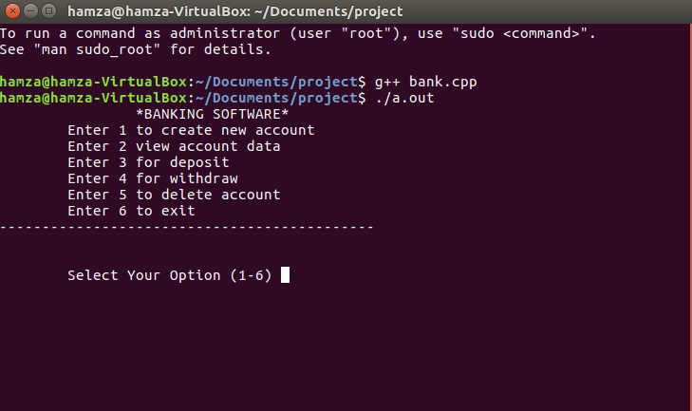
Screen shorts
8
Main MENU

Slide 9
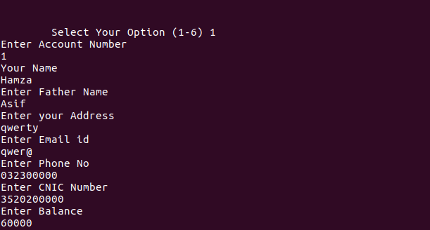
Screen shorts
9
Create New Account

Slide 10
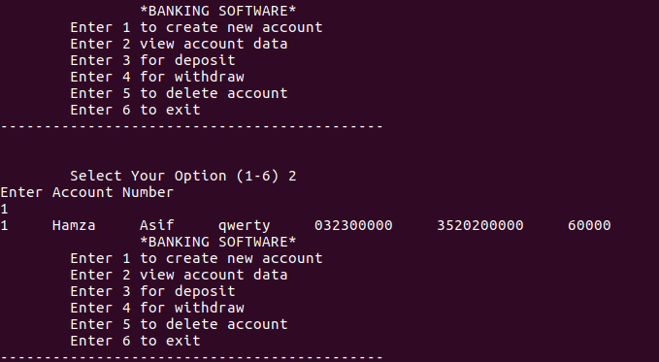
Screen shorts
10
View Account Information

Slide 11
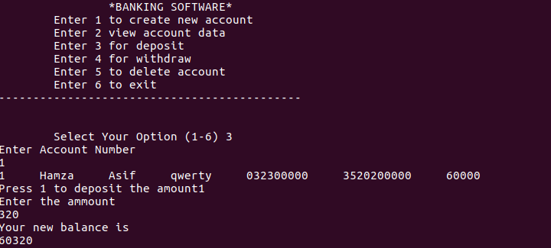
Screen shorts
11
Deposit

Slide 12
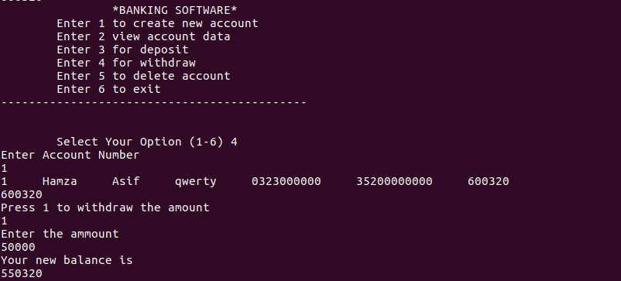
Screen shorts
12
Withdrawal

Slide 13
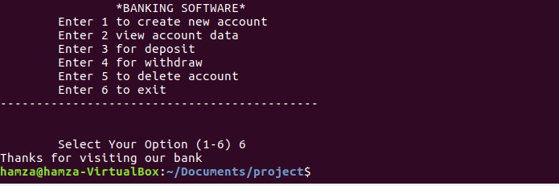
Screen shorts
13
Exit

Slide 14
14
THANK YOU

